Slide 1


Java/Eclipse Recap

Slide 2
Eclipse
IDE – Integrated Development Environment
  Many tools in one program
Workspaces – a way to organize projects
  Each workspace can have multiple projects
  We'll use one workspace for Minecraft and another for our lessons

Slide 3
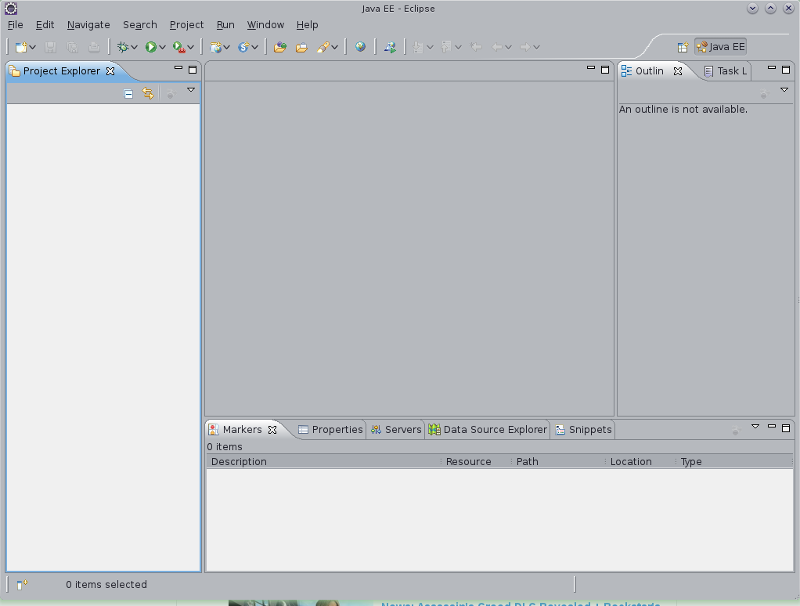
Our files will go
here!
Code will go here!
Code will go here!
Messages will go here!

Slide 4
Java
Java is a language and languages have rules
What are some rules of English?
Rules in Java:
  Sentences are called Statements
  Statements must end in a ;
  Classes and Methods must wrap their code with { and }

Slide 5
Java
Classes – are things
  public class Block { }
Variables – hold information
  int density = 1000;
Methods – do stuff
  public static void addRecipe(ItemStack output, ItemStack[][] input){ }

Slide 6
Java: Variables (Arrays)
public String[ ] myStringArray = new String[3];
myStringArray[0] = "Hello";
myStringArray[1] = "Coder";
myStringArray[2] = "Dojo";
Could look like this: { “Hello”, “Coder”, “Dojo” }
public String[ ][ ] myStringArray = new String[3][3];
Notes:
An array can hold multiple objects in one variable.
Who can tell me the name of this array variable?
The first statement creates a new array (myStringArray).
How many Strings does this variable hold? Let's see.
(Show statements) Three elements. Does anyone see anything weird about how we're storing our strings in the array? (Starts with 0). This is the Index of the array. In many programming languages an array's index starts at 0.
This is a good way to think about the elements in the array.
We can also have “multi-dimentional” arrays (they do not involve time travel). This is a 3 x 3 array (draw on board.) What does this remind you of? (draw lines like a crafting table)

Slide 7
BaseMod: RecipeHelper
Recipe[][] recipe =
{ { “cobblestone”, “cobblestone”, “cobblestone” },
{ “cobblestone”, “ ”, “cobblestone” },
{ “cobblestone”, “cobblestone”, “cobblestone” } };
recipe[0][0]
vertical
Horizontal
Notes:
Time to get back to Minecraft! What do you think a class called RecipeHelper does? (Adds custom recipes in our mod.)
This array could be representing what recipe? (Furnace)
In eclipse switch back to your other (Minecraft) workspace. Find the file BaseMod.java and open it.
Notice our recipe is making dirt into dirt. Delete the word dirt and hit ctrl + enter. Choose a new item to make!

Slide 8
Inheritance
Inheritance is one important feature about Object Oriented programming
What are some specific types of cars?
In Minecraft we're going to create our own blocks which will inherit abilities from the object Block

Slide 9
Objects in Java
Classes are Objects!
  Remember: classes have methods and variables
  Methods do stuff
  Variables hold information
In Java we show inheritance with the word “extends”
public class MyBlock extends Block

Slide 10
Our Custom Block
public class MyBlock extends Block {
public MyBlock(int id, Material material) {
super(id, material);
}
@Override
public void registerIcons(IconRegister iconRegister) {
this.blockIcon = iconRegister.registerIcon("BaseMod:test");
}
}

Slide 11
Adding Flair to our Block
public final static Block myBlock = new MyBlock(500, Material.ground)
.setHardness(0.5F)
.setStepSound(Block.soundMetalFootstep)
.setUnlocalizedName("myBlock")
.setCreativeTab(CreativeTabs.tabBlock)
.setLightValue(0.0F)
.setLightOpacity(0);

